Slide 1
MAGIC Tutorial
R

Slide 2
MAGIC (Markov Affinity-Based Graph Imputation of Cells
MAGIC imputes missing data values on sparse data sets, restoring the structure of the data
It also proves dimensionality reduction and gene expression visualizations
MAGIC can be performed on a variety of datasets
Here, we show the effectiveness of MAGIC on epithelial-to-mesenchymal transition (EMT) data
To use MAGIC, cite:
MAGIC: A diffusion-based imputation method reveals gene-gene interactions in single-cell RNA-sequencing data
Biorxiv (preprint) February 2017. DOI: doi.org/10.1101/111591

Slide 3
Installation
In R, run these commands to install MAGIC and all dependencies
library("devtools") install_github("KrishnaswamyLab/magic/R")
Perform analysis through test_magic.R
Run the function test_magic()

Slide 4
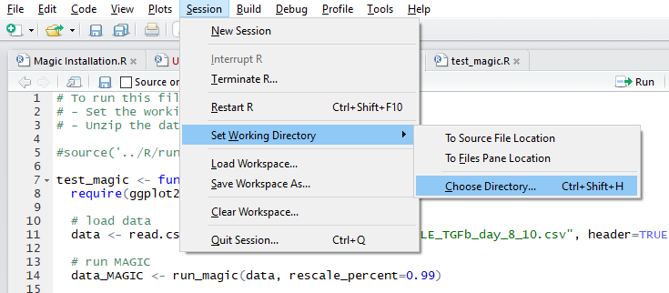
Loading Data
Set working directory to …magic/R/tests
Use setwd() OR (in Rstudio):
Data can be loaded as a .csv file using read.csv();
Categories must be specified separately from numerical data
Cell names are loaded as rows
Gene names are loaded as columns

Slide 5
EMT: Analysis
The following parameters are required to run MAGIC
npca: Number of PCA components (default = 20)
ka: Distance of kth nearest neighbor in adaptive kernel (default = 10)
k: (default = 30)
t: number of diffusion steps (specified automatically through optimal t analysis)
lib_size_norm: library size normalization (default = TRUE)
log_transform: apply log transformation to data (default = FALSE)
Rescale percent: percentile of the original data that the maximum value of each gene is rescaled to (default = 0.99)
Example:
data_MAGIC <- run_magic(data, rescale_percent=0.99)

Slide 6
EMT: Optimal t analysis
The optimal value of t is found separately and is automatically applied to the analysis
R2 vs. t
0.6
0.4
R2
0.2
0.0
●
1
2
3
4
5
6
7
8
9
10
11
12
t

Slide 7
EMT: Visualization
All visualizations are performed with the package ggplot2
Compare “before MAGIC” and “after MAGIC” data
p <- ggplot(data)
p_m <- ggplot(data_MAGIC)
Specify genes to be plotted
p + geom_point(aes(VIM, CDH1, colour=ZEB1)) + scale_colour_gradient(low = 'purple', high='yellow')
p_m + geom_point(aes(VIM, CDH1, colour=ZEB1)) + scale_colour_gradient(low = 'purple', high='yellow')

Slide 8
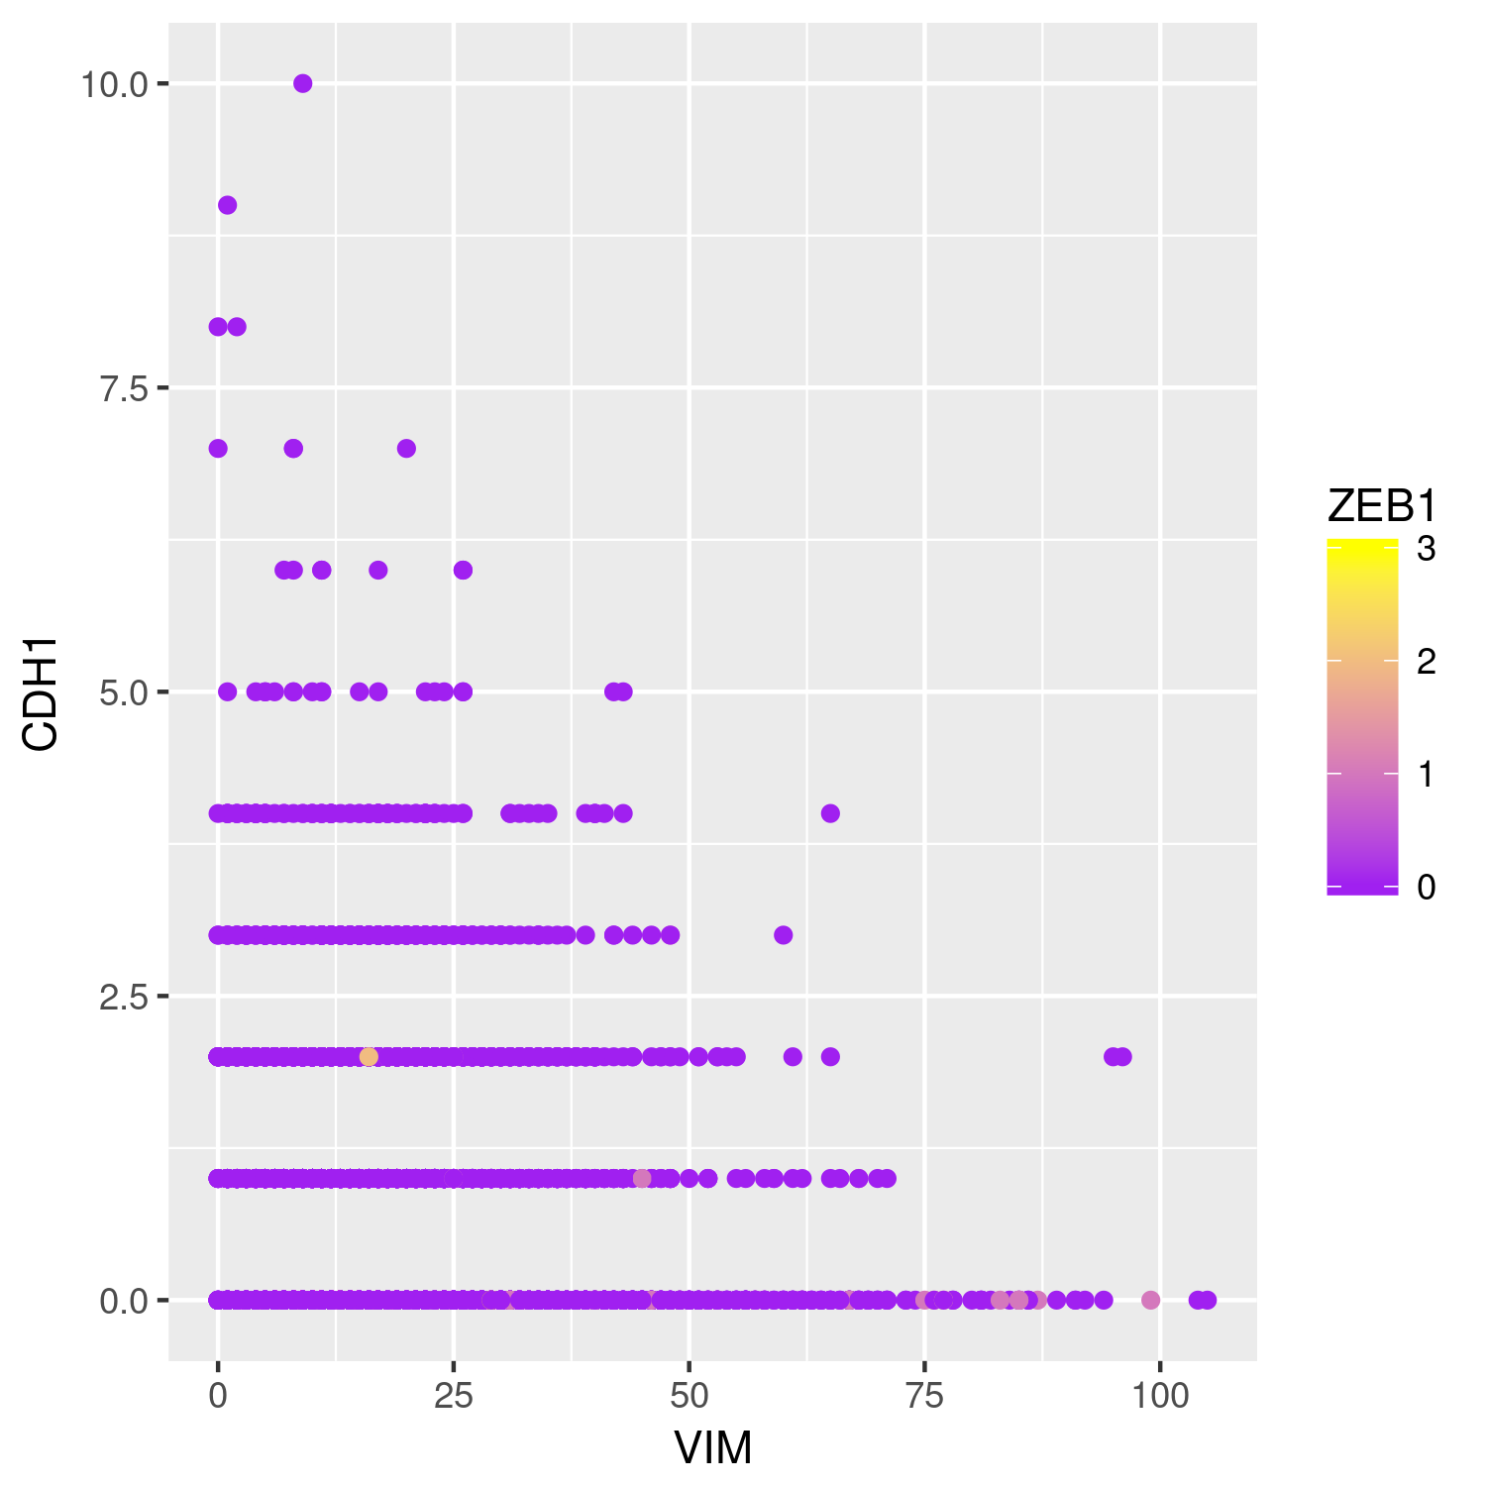
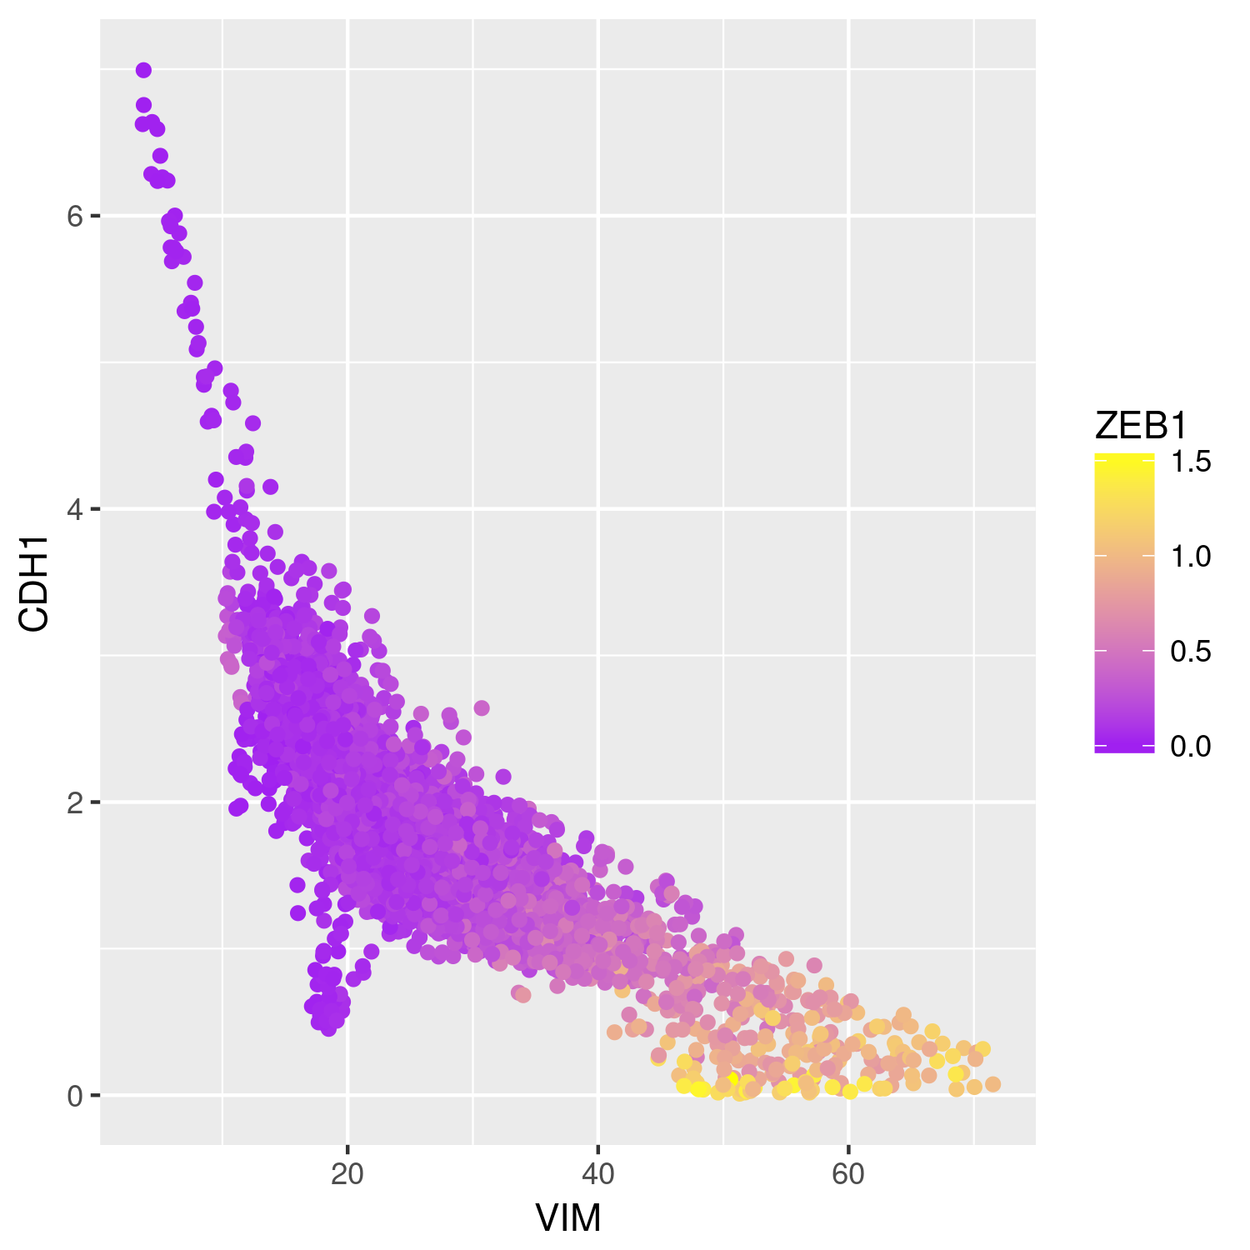
EMT: Visualization
Data (gene-gene relationships) can be visualized using 2-dimensional scatter plots
Raw data and MAGIC-transformed data can be easily compared
Before MAGIC
After MAGIC

Slide 9
Saving plots
Plots can be saved using ggsave()
ggsave('EMT_data_R_before_magic.png', width=5, height=5)
ggsave('EMT_data_R_after_magic.png', width=5, height=5)

